Slide 1
ExerciseMgr

Slide 2
Recap requirements:
Filter
Preview
Arrange Items
Do changes and create problem set

Slide 3
Progress:
General:
Code cleanup
Documentation
GUI-Design:
Many bug fixes
Changes on how the filter filters (“Rechenaufgabe”, exercises no semester, ..)
Filtering starts immediately now
Color indicators for selections in parent topic
Popup that shows topics/descriptive task and lets you edit them
Creates problem set in database if wanted
Buttons with no visual effect will light up shortly now
Added a settings file for database location and number of exercises per page

Slide 4
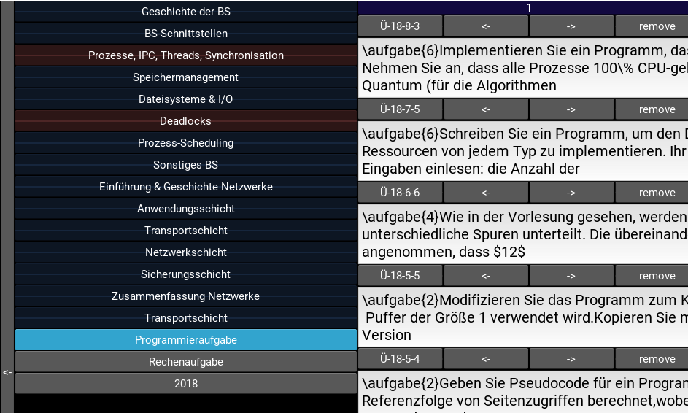
Implementation of requirements (filter)
Different filters
Most filters additive

Slide 5
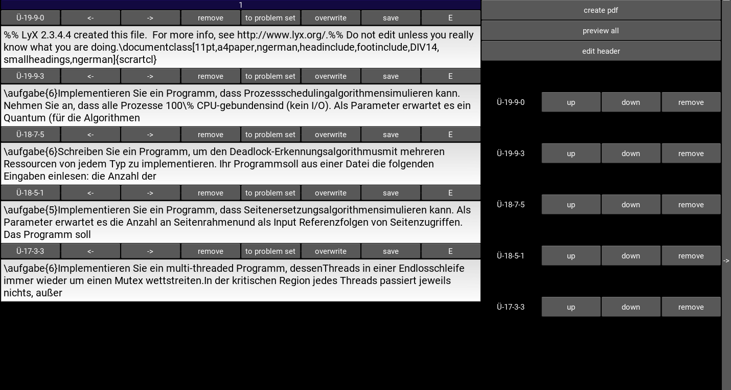
Implementation of requirements (preview)
Preview button allows easy view of all items in exit layout

Slide 6
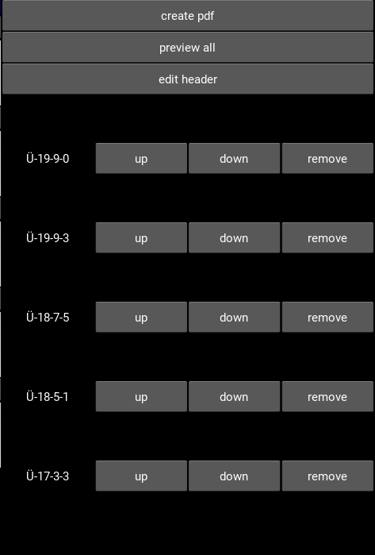
Implementation of requirements (arrangement)
Up/down/remove button to edit items in exit layout

Slide 7
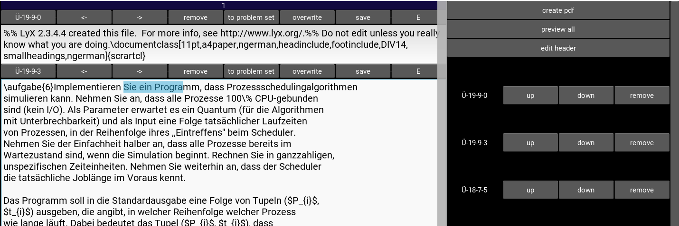
Implementation of requirements (create and change)
Exercise content can be edited and saved in TextInput

